Slide 1
_{LINUX PROCESS & THREAD}
Created by TuanPM3

Slide 2
PROCESS
CONCEPT
    Process is an instance of program
    Each process use separation virtual memory space (virtual address space)
    Code (text): contains object ﬁles (.o and executable)
    Static: contains the global variables and static variables
    Heap: dynamic memory allocation
    Stack: contains arguments and local variable
Notes:
Reference: http://www.enseignement.polytechnique.fr/informatique/INF583/INF583_5.pdf

Slide 3
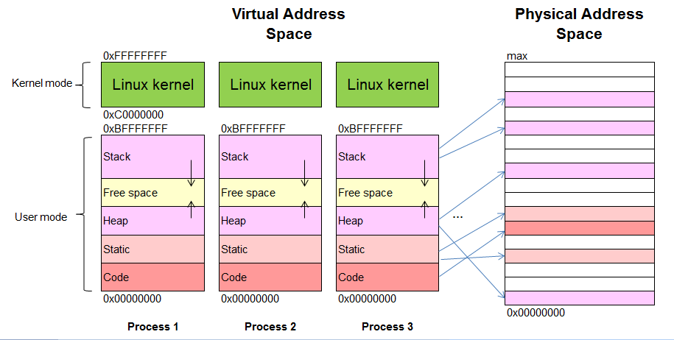
PROCESS
CONCEPT
Notes:
Reference: http://www.enseignement.polytechnique.fr/informatique/INF583/INF583_5.pdf

Slide 4
PROCESS
Interprocess communication (IPC)
    Message queue
    Shared memory
    Mapped memory
    Pipes
    FIFOs
    Sockets
Notes:
Reference : http://www.advancedlinuxprogramming.com/alp-folder/alp-ch05-ipc.pdf

Slide 5
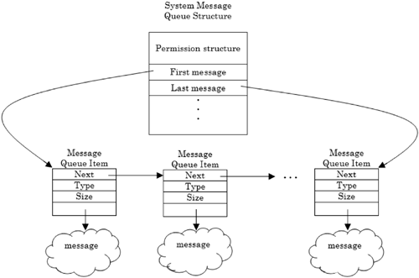
PROCESS
IPC - Message queue
Notes:
Allows processes transfer data via a queue
No need synchronization
Size of number of message, size of each message, total size of queue is limited (check : #ipcs -l)
number of message : /proc/sys/fs/mqueue/msg_max (default is 10)
size of each message : /proc/sys/kernel/msgmax (default 8192 Bytes)
total size of queue : /proc/sys/kernel/msgmnb (default 16384 Bytes)

Slide 6
PROCESS
IPC - Message queue
    #include <sys/types.h>
    #include <sys/ipc.h>
    #include <sys/msg.h>
    // message structure
    struct my_msg_st {
    long mtype;
    char mtext[MSG_SIZE];
    };

Slide 7
PROCESS
IPC - Message queue
    int msgget(key_t key, int msgflg);
    int msgsnd(int msqid, const void *msgp, size_t msgsz, int msgflg);
    ssize_t msgrcv(int msqid, void *msgp, size_t msgsz, long msgtyp,int msgflg);
    int msgctl(int msqid, int cmd, struct msqid_ds *buf);
Notes:
int msgget(key_t key, int msgflg);
key : key of message queue (if key = IPC_PRIVATE => use internal of process)
msgflg : The flags include permissions and can optionally contain IPC_CREAT and IPC_EXCL (ex: 0600 | IPC_CREAT | IPC_EXCL)
int msgsnd(int msqid, const void *msgp, size_t msgsz, int msgflg);
msgflg : If flags includes the IPC_NOWAIT flag then an error code is returned if the message queue is currently full
ssize_t msgrcv(int msqid, void *msgp, size_t msgsz, long msgtyp, int msgflg);
msgflg : MSG_NOERROR, MSG_EXCEPT, IPC_NOWAIT
int msgctl(int msqid, int cmd, struct msqid_ds *buf);
cmd : IPC_STAT, IPC_SET, IPC_RMID …

Slide 8
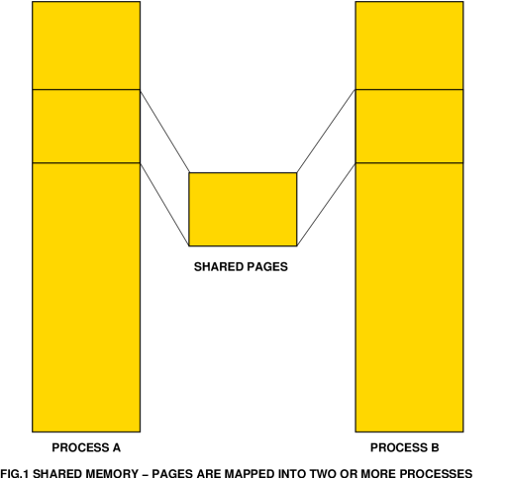
PROCESS
IPC - Share memory
Notes:
Reference : http://www.advancedlinuxprogramming.com/alp-folder/alp-ch05-ipc.pdf
Allows processes to access the same memory
When one process changes the memory, all the other processes see the modification
The fastest form of IPC
Synchronization is must provide by application itselt
Limit :
- Maximum size in bytes for a shared memory segment: /proc/sys/kernel/shmmax
- Minimum size in bytes for a shared memory segment : 1 Byte
- System wide maximum number of shared memory segments : /proc/sys/kernel/shmmni (Default 4096)

Slide 9
PROCESS
IPC - Share memory
    #include <sys/ipc.h>
    #include <sys/shm.h>
    int shmget(key_t key, size_t size,
    int shmflg);
    void *shmat(int shmid, const void *shmaddr, int shmflg);
    int shmdt(const void *shmaddr);
    int shmctl(int shmid, int cmd, struct shmid_ds *buf);
Notes:
int shmget(key_t key, size_t size, int shmflg);
key : IPC_PRIVATE or a key_value
size : size of segment (round up)
shmflg : 0600, 0600 | IPC_CREAT, 0600 | IPC_CREAT | IPC_EXCL
return -1 if fail
void *shmat(int shmid, const void *shmaddr, int shmflg);
shmflg : 0 (read + write), SHM_RDONLY (read only)
return (void *) -1 if fail
int shmdt(const void *shmaddr);
return -1 if fail
int shmctl(int shmid, int cmd, struct shmid_ds *buf);
cmd : IPC_RMID, IPC_STAT, IPC_SET …
buf: struct shmid_ds {
struct ipc_perm shm_perm; /* Ownership and permissions */
size_t shm_segsz; /* Size of segment (bytes) */
time_t shm_atime; /* Last attach time */
time_t shm_dtime; /* Last detach time */
time_t shm_ctime; /* Last change time */
pid_t shm_cpid; /* PID of creator */
pid_t shm_lpid; /* PID of last shmat(2)/shmdt(2) */
shmatt_t shm_nattch; /* No. of current attaches */
...
};

Slide 10
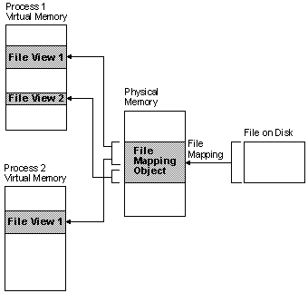
PROCESS
IPC - Mapped memory
Notes:
Reference : http://www.advancedlinuxprogramming.com/alp-folder/alp-ch05-ipc.pdf
Permits different processes to communicate via a file
Process can read & writing the file’s contents with ordinary memory access
Linux handles the file reading and writing operations
Run faster than explicit file I/O operations

Slide 11
PROCESS
IPC - Mapped memory
    #include <sys/mman.h>
    void *mmap(void *addr, size_t length,
    int prot, int flags, int fd,
    off_t offset);
    void *mmap64(void *addr, size_t length, int prot, int flags, int fd,
    off64_t offset);
    int munmap(void *addr, size_t length);
Notes:
void *mmap(void *addr, size_t length, int prot, int flags, int fd, off_t offset);
addr : starting address (in virtual address space) for the new mapping
length : size in bytes of the mapping
prot : desired memory protection of the mapping (and must not conflict with the open mode of the file)
PROT_NONE , PROT_EXEC, PROT_READ, PROT_WRITE
flags :
MAP_SHARED : any writes immediately transferred to the underlying file and made visible to other processes
MAP_PRIVATE
fd : file description
offset : offset from begin of the file to start mapping, must be a multiple of the page size as returned by sysconf(_SC_PAGE_SIZE)
RETURN VALUE :
success : returns a pointer to the mapped area
fail : MAP_FAILED
int munmap(void *addr, size_t length);
RETURN VALUE :
success : 0
fail : -1

Slide 12
PROCESS
IPC - Pipes
fd[1]
fd[0]
Write
Pipe
Read
Notes:
Reference : http://www.advancedlinuxprogramming.com/alp-folder/alp-ch05-ipc.pdf
Unidirectional communication
Used to communicate between two threads in a single process or between parent and child processes
A pipe ’s data capacity is limited (Default pipe limit = 8*512 Byte = 4Kb)
Check: ulimit –a
Setting : ulimit -p

Slide 13
PROCESS
IPC – Pipes
    #include <unistd.h>
    int pipe_fds[2];
    int read_fd;
    int write_fd;
    pipe(pipe_fds);
    read_fd = pipe_fds[0];
    write_fd = pipe_fds[1];
    FILE *stream = fdopen (fds[0], “r”);
    FILE *stream = fdopen (fds[1], “w”);
Notes:
Data written to the file descriptor write_fd can be read back from read_fd .
pipe (pipe_fds);
Create pipe, File descriptors for the two ends of the pipe are placed in pipe_fds[0], pipe_fds[1]

Slide 14
PROCESS
IPC - FIFOs
Write
FIFO
Read
Notes:
Reference : http://www.advancedlinuxprogramming.com/alp-folder/alp-ch05-ipc.pdf
A first-in, first-out (FIFO) file is a pipe that has a name in the filesystem
Access a FIFO just like an ordinary file
Any process can open or close the FIFO
Can create, read, write, remove FIFO on shell
Create : mkfifo /tmp/fifo
Read : cat < /tmp/fifo
Write : cat /tmp/fifo
Remove : rm /tmp/fifo

Slide 15
PROCESS
IPC – FIFOs
    #include <sys/types.h>
    #include <sys/stat.h>
    int mkfifo(const char *path, mode_t mode);
Notes:
int mkfifo ( const char *path, mode_t mode );
path : Names the new file
mode : file's permissions (refer : man open)
Either low-level I/O functions (open, write, read, close, and so on, as listed in Appendix B,
“Low-Level I/O”) or C library I/O functions ( fopen, fprintf, fscanf , fclose , and so
on) may be used to access the FIFO
int fd = open (fifo_path, O_WRONLY);
write (fd, data, data_length);
close (fd);
Or
FILE* fifo = fopen (fifo_path, “r”);
fscanf (fifo, “%s”, buffer);
fclose (fifo);

Slide 16
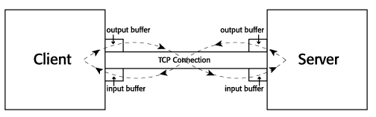
PROCESS
IPC - Socket
Notes:
Reference :
- http://www.tutorialspoint.com/unix_sockets/socket_core_functions.htm
http://pic.dhe.ibm.com/infocenter/tpfhelp/current/index.jsp?topic=%2Fcom.ibm.ztpf-ztpfdf.doc_put.cur%2Fgtpc2%2Fcpp_read.html
Communicate with between processes on the same computer or difference computers
Bidirectional communication
TCP : input buffer 65535 Bytes, output buffer upto 1Gb

Slide 17
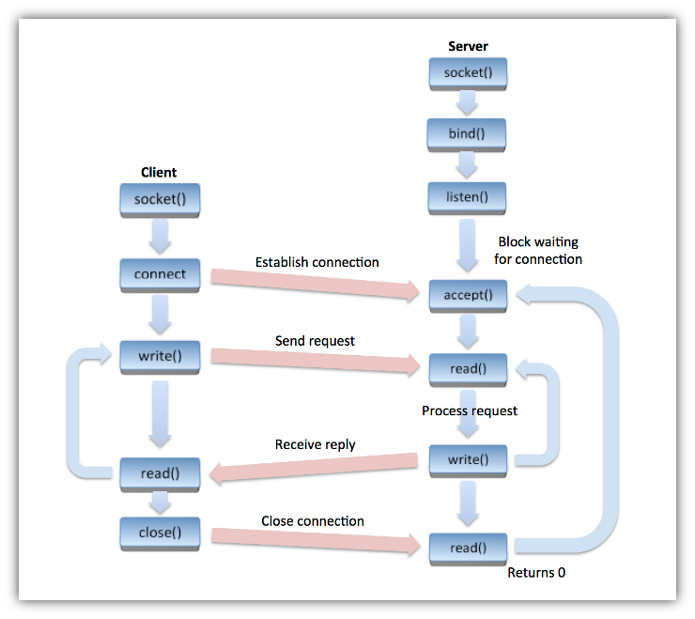
PROCESS
IPC - Socket

Slide 18
PROCESS
IPC – Socket
    #include <sys/socket.h>
    int socket(int domain, int type,
    int protocol);
    int bind(int sockfd, struct sockaddr *my_addr, int addrlen);
    int connect(int sockfd, struct sockaddr *serv_addr, int addrlen);
    int listen(int sockfd, int backlog);
    int accept(int sockfd, struct sockaddr cliaddr, socklen_t *addrlen);

Slide 19
PROCESS
IPC – Socket
    int write(int sockfd, char *buf, int len);
    int read(int sockfd, char *buf, int len);
    int close(int sockfd);

Slide 20
PROCESS
    Synchronization – Semaphores
      Resolve conflict when access resource
      Ensure the sequence in processing
      2 types : System V Semaphores and POSIX Semaphores
Notes:
Reference : http://www.advancedlinuxprogramming.com/alp-folder/alp-ch05-ipc.pdf
http://www.linuxdevcenter.com/pub/a/linux/2007/05/24/semaphores-in-linux.html?page=4

Slide 21
PROCESS
    Synchronization – System V Semaphores
      #include <sys/types.h>
      #include <sys/ipc.h>
      #include <sys/sem.h>
      int semget(key_t key, int nsems, int semflg);
      int semop(int semid, struct sembuf *sops, unsigned nsops);
      int semctl(int semid, int semnum, int cmd, ...);
Notes:
int semget(key_t key, int nsems, int semflg); // get a semaphore set identifier, return -1 if fail
nsems: number of semaphore in semaphore set
semflg : 0600 | IPC_CREAT | IPC_EXCL
int semop(int semid, struct sembuf *sops, unsigned nsops); // semaphore operations
semid : id of semaphore
sops : array of semaphore operation structure
nsops : number of semaphore want to oprerate with
int semctl(int semid, int semnum, int cmd, ...); // semaphore control operations
Link : -pthread

Slide 22
PROCESS
    Synchronization – System V Semaphores
struct sembuf {
unsigned short sem_num; /* semaphore number */
short sem_op; /* semaphore operation */
short sem_flg; /* operation flags */
}
Notes:
sem_flg : IPC_NOWAIT, SEM_UNDO
Ex :
/* Wait on a binary semaphore. Block until the semaphore value is positive, then decrement it by 1. */
int binary_semaphore_wait (int semid)
{
struct sembuf operations[1];
/* Use the first (and only) semaphore. */
operations[0].sem_num = 0;
/* Decrement by 1. */
operations[0].sem_op = -1;
/* Permit undo’ing. */
operations[0].sem_flg = SEM_UNDO;
return semop (semid, operations, 1);
}
/* Post to a binary semaphore: increment its value by 1. This returns immediately. */
int binary_semaphore_post (int semid)
{
struct sembuf operations[1];
/* Use the first (and only) semaphore. */
operations[0].sem_num = 0;
/* Increment by 1. */
operations[0].sem_op = 1;
/* Permit undo’ing. */
operations[0].sem_flg = SEM_UNDO;
return semop (semid, operations, 1);
}

Slide 23
PROCESS
    Synchronization – POSIX Semaphores
    #include <fcntl.h> /* For O_* constants */
    #include <sys/stat.h> /* For mode constants */
    #include <semaphore.h>
    sem_t *sem_open(const char *name, int oflag);
    int sem_wait(sem_t *sem);
    int sem_post(sem_t *sem);
    int sem_close(sem_t *sem);
Notes:
Link : -pthread

Slide 24
PROCESS
    Differences between System V and POSIX semaphores
In System V can control how much the semaphore count can be increased or decreased; whereas in POSIX, the semaphore count is increased and decreased by 1
POSIX semaphores do not allow manipulation of semaphore permissions, whereas System V semaphores allow to change the permissions of semaphores
Initialization and creation of semaphores is atomic (from the user's perspective) in POSIX
From a usage perspective, System V semaphores are clumsy, while POSIX semaphores are straight-forward
In POSIX semaphores, the semaphore is cleaned up when process exit

Slide 25
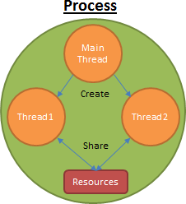
THREAD
Concept
    Lightweight process (LWP)
    Shares reosource and with its process
Notes:
Reference: http://www2.latech.edu/~box/os/ch04.pdf

Slide 26
THREAD
Thread management
  Create thread
    #include <pthread.h>
    int pthread_create(
    pthread_t *thread,
    pthread_attr_t *attr,
    void *(*start_routine)(void *),
    void *arg);
  Terminate calling thread
  void pthread_exit(void *retval);
Notes:
Compile and link with -pthread.
Set attr before create thread :
pthread_attr_t tattr;
pthread_attr_init(&tattr);
pthread_attr_setdetachstate (&tattr, PTHREAD_CREATE_DETACHED);
pthread_attr_destroy(&tattr);
void pthread_exit(void *retval);
Terminates the calling thread and returns a value via retval that (if the thread is joinable) is available to another thread in the same process that calls pthread_join().

Slide 27
THREAD
Thread management
  Send a cancellation request to a thread
  int pthread_cancel(pthread_t thread);
  Set cancelability state
  int pthread_setcancelstate(int state, int *oldstate);
  Set cancelability type
  int pthread_setcanceltype(int type, int *oldtype);
  Join thread
  int pthread_join(pthread_t thread,
  void **retval);
Notes:
int pthread_cancel(pthread_t thread);
Whether and when the target thread reacts to the cancellation request depends on two attributes that are under the control of that thread: its cancelability state and type

Slide 28
THREAD
Multiple threads communication
  Via global variables
  Using IPC (same as processes communication)
Synchronization
  Semaphore
  Mutex
  Conditional variable

Slide 29
THREAD
Synchronization – Mutex
  Init
  #include <pthread.h>
  pthread_mutex_t mutex;
  int pthread_mutex_init(pthread_mutex_t *mutex,
  const pthread_mutexattr_t *attr);
  or
  pthread_mutex_t mutex = PTHREAD_MUTEX_INITIALIZER;
  Destroy
  int pthread_mutex_destroy(
  pthread_mutex_t *mutex);
Notes:
Reference : http://www.advancedlinuxprogramming.com/alp-folder/alp-ch04-threads.pdf
If successful, the pthread_mutex_init() and pthread_mutex_destroy() functions return zero. Otherwise, an error number is returned to indicate the error

Slide 30
THREAD
Synchronization – Mutex
  Lock
  int pthread_mutex_lock(
  pthread_mutex_t *mutex);
  Unlock
  int pthread_mutex_unlock(
  pthread_mutex_t *mutex);
Notes:
If successful, the pthread_mutex_lock() and pthread_mutex_unlock() functions return 0. Otherwise, an error number is returned to indicate the error.

Slide 31
THREAD
Synchronization – Conditional variable
  Init
  #include <pthread.h>
  pthread_cond_t cond = THREAD_COND_INITIALIZER;
  Or
  int pthread_cond_init(pthread_cond_t *cond, pthread_condattr_t *cond_attr);
  Destroy
  int pthread_cond_destroy(pthread_cond_t *cond);

Slide 32
THREAD
Synchronization – Conditional variable
  Wait
  int pthread_cond_wait(pthread_cond_t *cond, pthread_mutex_t *mutex);
  Signal
  int pthread_cond_signal(pthread_cond_t *cond);

Slide 33
THANKS FOR YOUR ATTENSION!

